Slide 1
COMPLAINT ANALYSIS
Group 4
Tanmay Talekar Disha Kadam Parvathy Nair Rahul Panchal Sankar Murugan

Slide 2
Introduction
Complaint Analysis Complaints filed against Insurance Companies
The objective of our analysis is to study the reasons of the complaint and suggest some points to avoid them.
Our dataset contains a list of consumer complaints filed against Insurance companies. This dataset includes the Nature of Complaints, Line of Business, Reason of Complaint, Recovery and Conclusion.

Slide 3
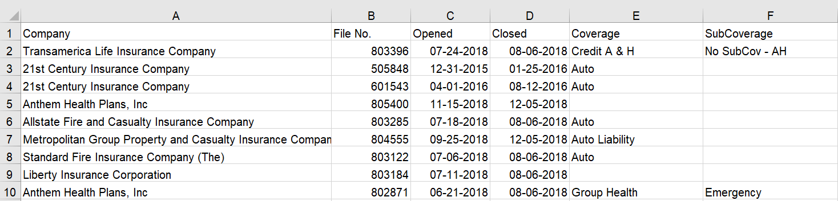
DATA
Column Name | Description | Size
Company | Companies against complaints received. | 671
File No | Complaint Number in a particular company. | 18018
Opened | Date of opening for the complaint. | 18018
Closed | Date of closing of the complaint. | 17598
Coverage | Type of Insurance | 70
Sub-Coverage | Amount of risk covered for specific disease or treatment | 73

Slide 4
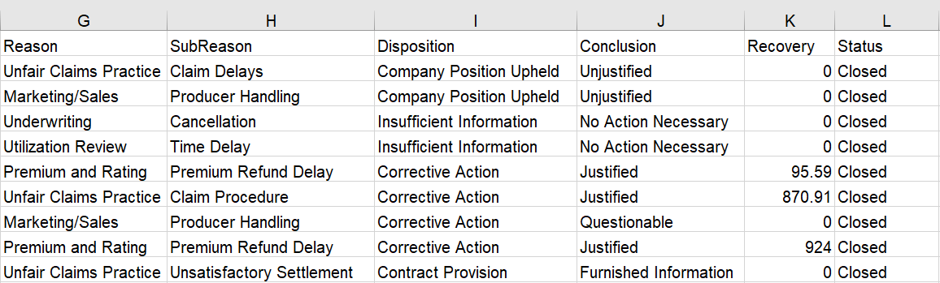
DATA
Column Name | Description | Size
Reason | Written expression of dissatisfaction by complainant | 12
Sub Reason | Detailed expression of dissatisfaction under reason of complaint | 69
Disposition | Stand of company against the complaint | 54
Conclusion | Final conclusion of the complaint | 9
Recovery | Compensation paid by the company to the complainant | 2224
Status | Status of Complaint (Opened or Closed) | 5

Slide 5
Approach towards Dashboard
Analyze past data by months and year
Review key reasons of Complaints, their resolution time, compensation paid.
Analyse the final conclusion and identify ways to reduce complaints

Slide 6
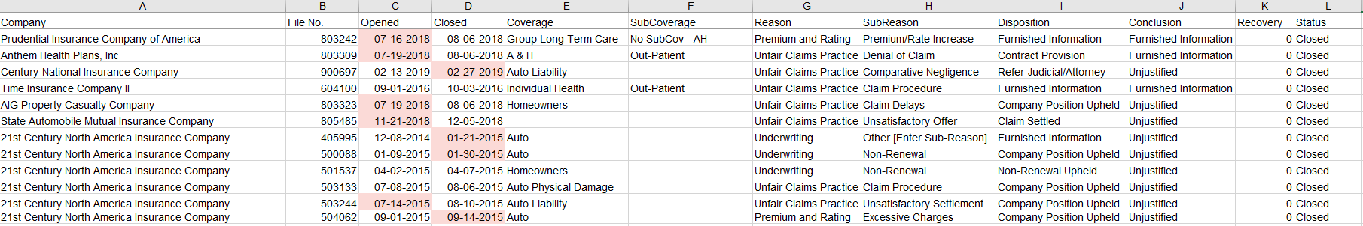
Data Cleaning
Data Cleaning using Excel
Select Columns Opened and Closed -> Use Data Tool [Text to Column] -> Select Column Date format to Month/Date/Year
Add column “Resolution Time” by using formula =[Closed-Opened]
Select ‘Number’ format for Resolution Time with 0 decimals, as it is in days.
Change “Recovery” column to Currency format.
Duplicates
Pros: Efficient/Accurate Data Cons: Same file no. even if companies are different, which may lead to error conclusion.

Slide 7
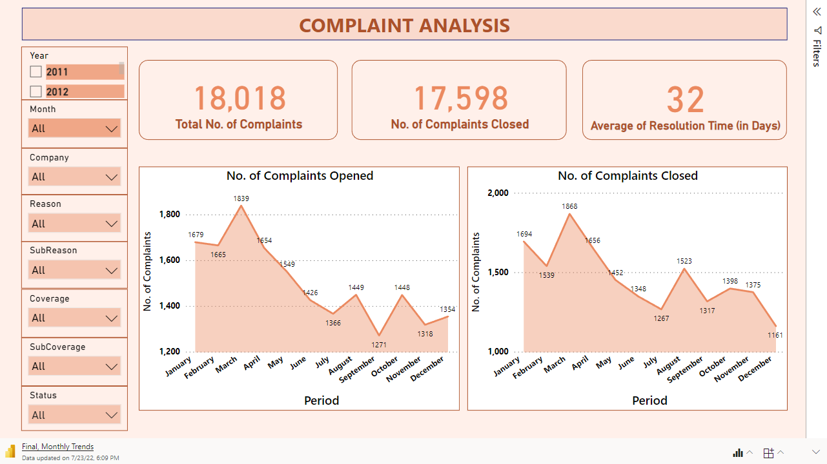

Slide 8
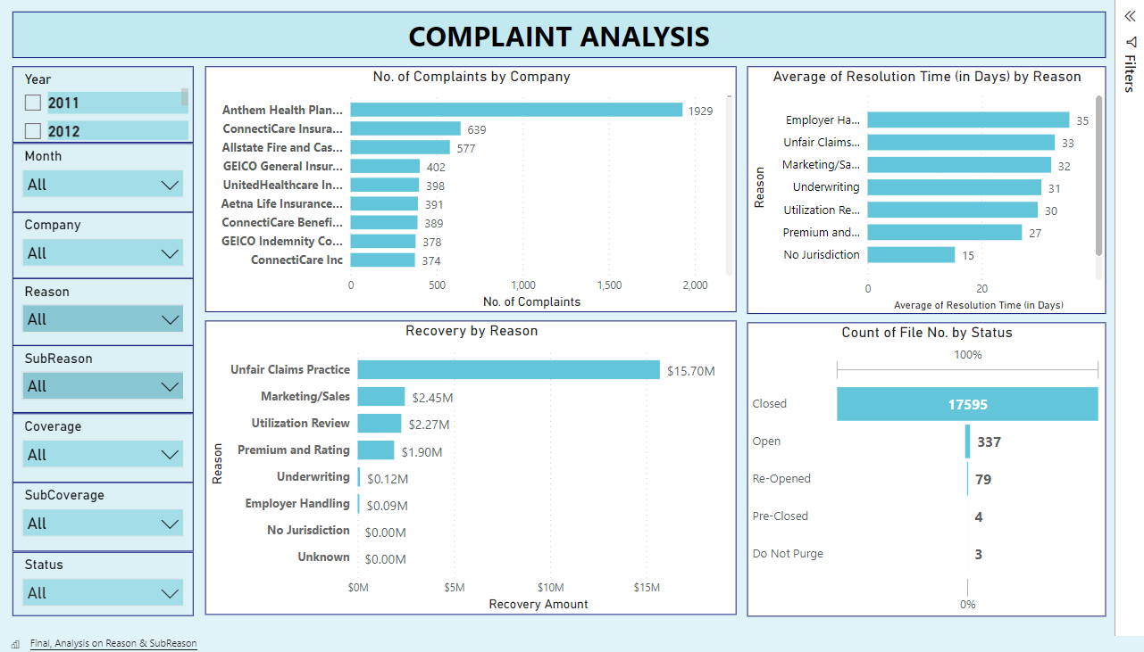

Slide 9
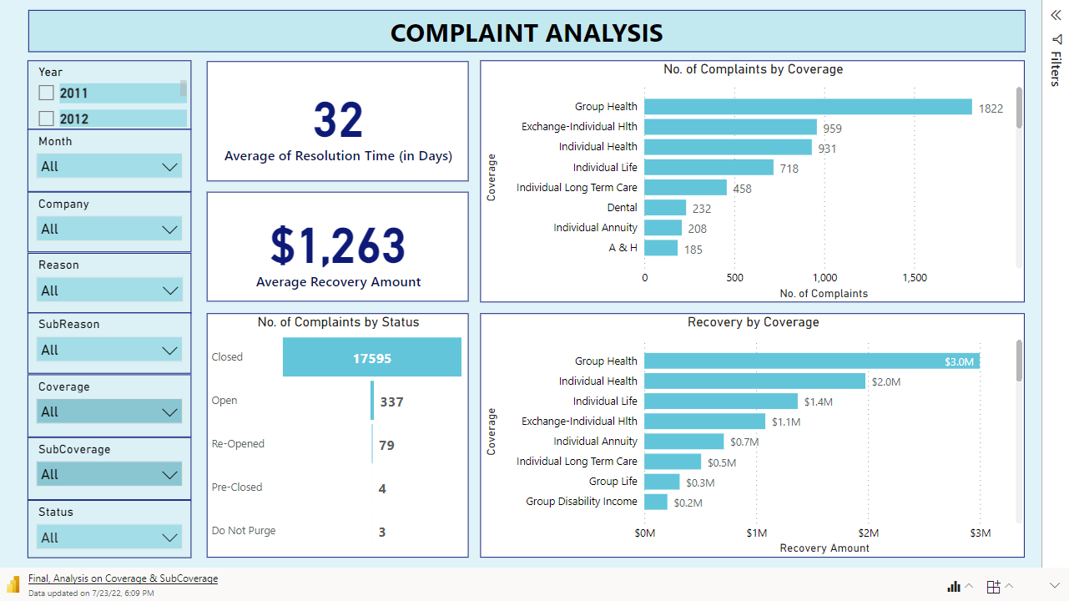

Slide 10
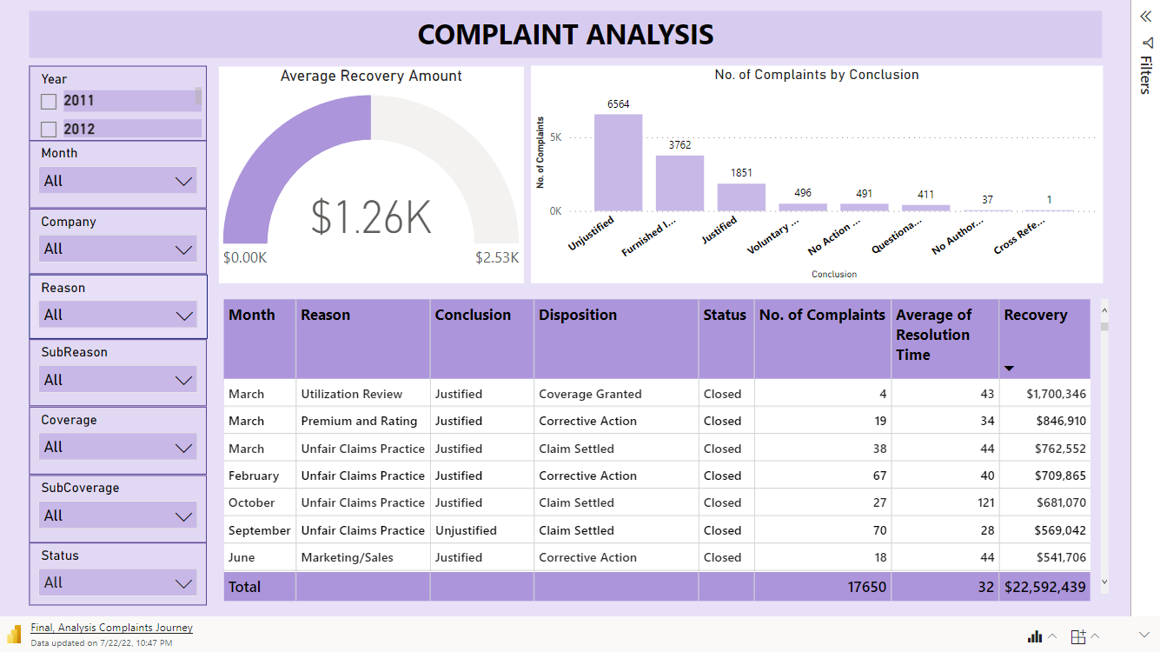

Slide 11
